Slide 1
Basic Model & Load Calculation
Prepared by: Md. Yasin Arafat

Slide 2
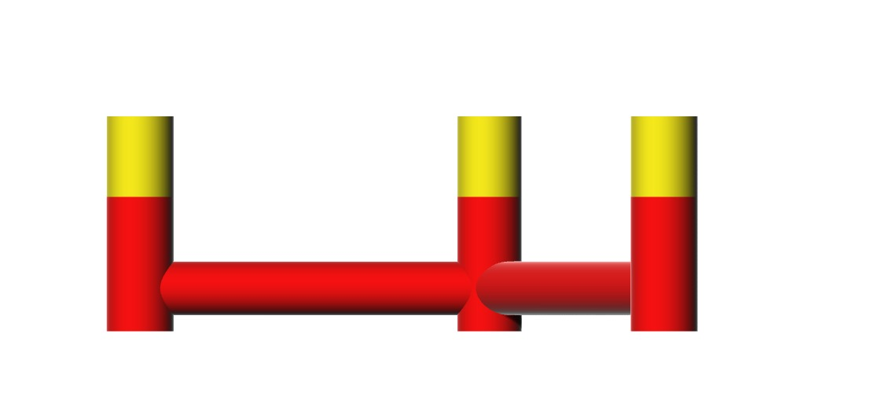
Shell Model

Slide 3
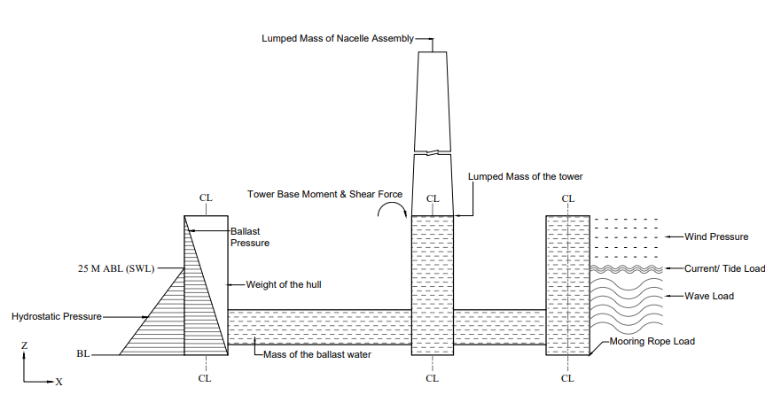
Load Diagram

Slide 4
Calculated Load Cases
Permanent Loads:
Weight of rotor components and equipment inside the nacelle, machinery, equipment, tower etc.
Hydrostatic Pressure
Ballast Pressure
Pre-tension in mooring lines
Static earth pressure
Variable Loads:
Bending moment on shear force due to turbine thrust

Slide 5
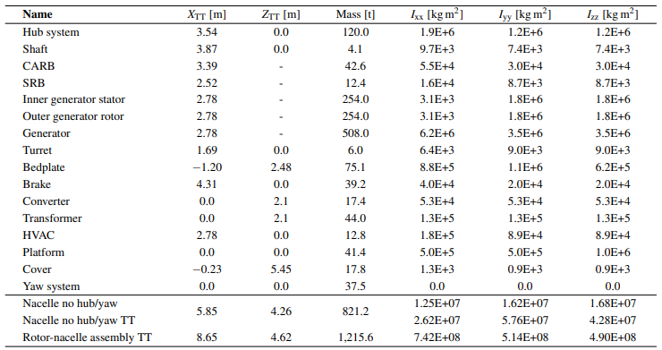
Permanent Loads
Mass:

Slide 6
Permanent Loads
Mass:
Name | Mass (t) | I_{xx} [KG. m²] | Iyy [KG. m²] | I_{zz} [KG. m²]
Column 1 Ballast | 4898.1 | 6.98E+08 | 6.98E+08 | 9.49E+07
Column 2 Ballast | 4898.1 | 6.98E+08 | 6.98E+08 | 9.49E+07
Column 3 Ballast | 4898.1 | 6.98E+08 | 6.98E+08 | 9.49E+07
Central Column Ballast | 4514 | 6.40E+08 | 6.40E+08 | 8.08E+07
Pontoon 1 Ballst | 4225.2 | 5.28E+07 | 1.05E+09 | 1.05E+09
Pontoon 2 Ballst | 4224.9 | 1.05E+09 | 5.28E+07 | 1.05E+09
Pontoon 3 Ballst | 4224.9 | 1.05E+09 | 5.28E+07 | 1.05E+09
Tower | 1574

Slide 7
Permanent Loads
Pre tension In mooring line:
Line breaking strength MN 103.8
Its weight alone is approximately 26.14 MN.
Load on fairlead can’t exceed 103.8 MN
Static Earth pressure:
Not Applicable I Think

Slide 8
Variable Loads
Tower Base moment and shear force
Formula for moment, M= Thrust x Tower Height
Formula for shear force, Fs= -Thrust
Both formulas are verified by Ansys prob tool.
Result:
Next Page

Slide 9
Variable Loads
Result:
Wind Speed (m/s) | Pitch (deg) | Rotor Speed (rpm) | Thrust (KN) | Moment (KN.M) | Shear Force KN
3 | 0.58064 | 1.84662 | 464 | 71920 | -464
4 | 0.33798 | 2.46216 | 622 | 96410 | -622
5 | 0.00915 | 3.0777 | 812 | 125860 | -812
6 | -0.33797 | 3.69324 | 1158 | 179490 | -1158
7 | -0.63879 | 4.30878 | 1557 | 241335 | -1557
8 | -0.97996 | 4.92432 | 2011 | 311705 | -2011
9 | -1.3268 | 5.53986 | 2482 | 384710 | -2482
10 | 0.73192 | 6.1554 | 2658 | 411990 | -2658
11 | 2.42859 | 6.77094 | 2768 | 429040 | -2768
12 | 5.09471 | 7.0611 | 2478 | 384090 | -2478
13 | 7.26585 | 7.0611 | 2209 | 342395 | -2209
14 | 9.01413 | 7.0611 | 2008 | 311240 | -2008
15 | 10.53731 | 7.0611 | 1859 | 288145 | -1859
16 | 11.91818 | 7.0611 | 1733 | 268615 | -1733
17 | 13.20451 | 7.0611 | 1658 | 256990 | -1658
18 | 14.42148 | 7.0611 | 1543 | 239165 | -1543
19 | 15.58471 | 7.0611 | 1451 | 224905 | -1451
20 | 16.70423 | 7.0611 | 1382 | 214210 | -1382
21 | 17.7886 | 7.0611 | 1322 | 204910 | -1322
22 | 18.84311 | 7.0611 | 1268 | 196540 | -1268
23 | 19.87209 | 7.0611 | 1222 | 189410 | -1222
24 | 20.87848 | 7.0611 | 1178 | 182590 | -1178
25 | 21.86473 | 7.0611 | 1152 | 178560 | -1152

Slide 10
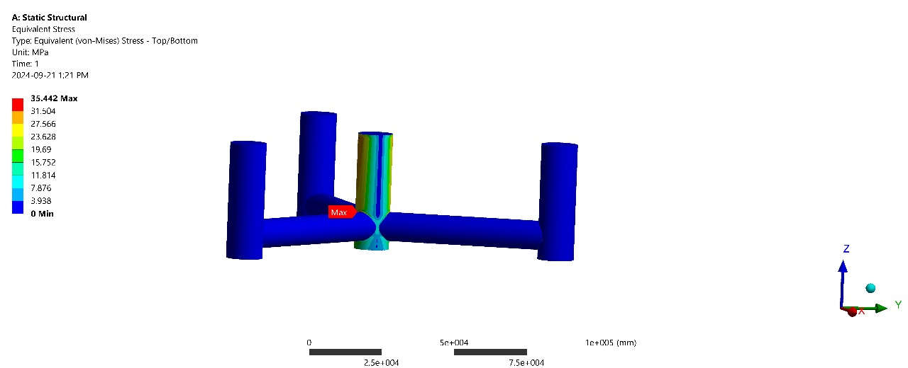
Stress At Tower Base Moment

Slide 11
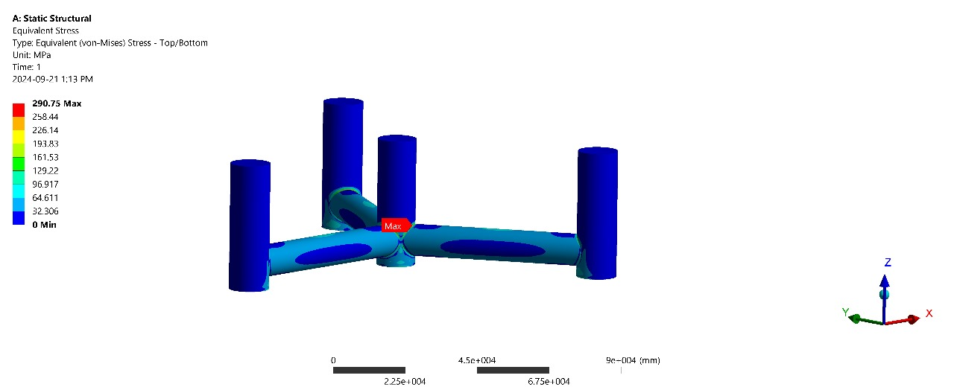
Stress At Hydrostatic Pressure

Slide 12
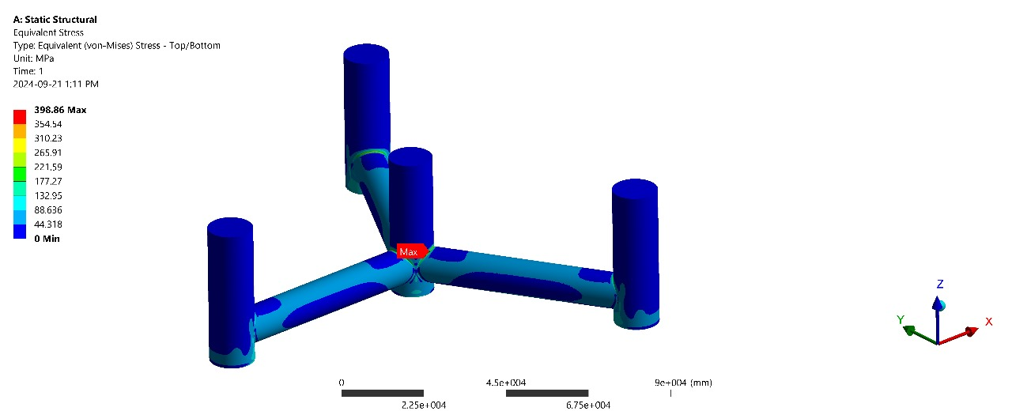
Stress At Ballast Pressure Pressure

Slide 13
Stress At Ballast Pressure Pressure

Slide 14
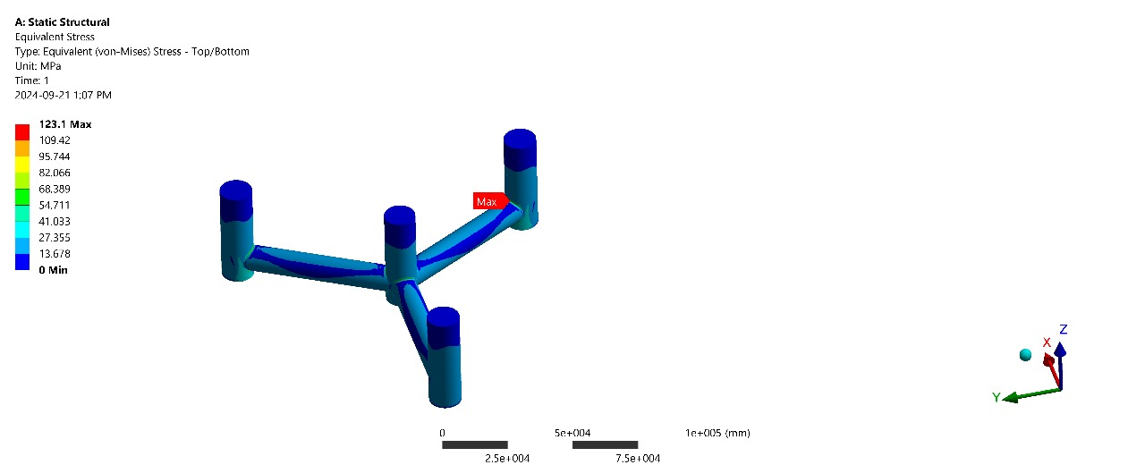
Stress All Load Combined

